Slide 1
Excitation of Electron
Electronic transition
Photochemical excitation:
Involves the transfer of a electron from a lower orbital to a higher one
E
antibonding
bonding
Arnold, D.R.; Baird, N.C.; Bolton, J.R.; Brand, J.C.D.; Jacobs, P.W.M.; de Mayo, P.; Ware, W.R. Photochemistry An Introduction, Academic Press Inc., New York, 1974

Slide 2
Options Available To An Excited Molecule
Photochemical reaction
Photochemically excited molecule:
Non-radiative (deactivation) processes between states
Radiative processes between states
Intermolecular energy transfer
Chemical reaction
A + hν’ (emission)
A + heat (radiationless decay)
A + hν
A*
C* (change excited state)
B
B* + A (energy transfer)
(i.e.: sensititzer)
chemical reaction
Arnold, D.R.; Baird, N.C.; Bolton, J.R.; Brand, J.C.D.; Jacobs, P.W.M.; de Mayo, P.; Ware, W.R. Photochemistry An Introduction, Academic Press Inc., New York, 1974

Slide 3
Multiplicity of electronic states
S : spin quantum number
Terms derived from: 2 S + 1
S = 0 singlet (S_{i})
S = ½ doublet (D_{i})
S = 1 triplet (T_{i})

Slide 4
Multiplicity of electronic states
Electronic transition
Multiplicity: Singlet VS Triplet
Sum of the angular quantum number S in (2S+1)
Each electron has a value of 1/2
Paired spin: ½ - ½ =0 → S = 0, multiplicty is 1 (singlet)
Unpaired spin: ½ + ½ =1 → S = 1, multiplicity is 3 (triplet)
LUMO
HOMO
Antiparrallel Spin
Paired Spin
S₁
Parrallel Spin
Unpaired Spin
T₁
Arnold, D.R.; Baird, N.C.; Bolton, J.R.; Brand, J.C.D.; Jacobs, P.W.M.; de Mayo, P.; Ware, W.R. Photochemistry An Introduction, Academic Press Inc., New York, 1974

Slide 5
Jablonski Diagram
A Jablonski Diagram depicts the electronic states of a molecule and the transitions amongst them
Note that all transitions from one electronic state to another originate from the lowest vibrational level of the initial electronic state. For example, fluorescence occurs only from S1, because the higher singlet states (S2, etc.) decay so rapidly by internal conversion that fluorescence from these states cannot compete.
E
S_{n}
E: Energy
A: Photon absorption
F: Fluorescence (R)
P: Phosphorescence (R)
S: Singlet state
T: Triplet state
IC: Internal conversion (N-R)
ISC: Intersystem crossing (N-R)
S₂
IC
S₁
ISC
A
F
T₁
P
S₀
Electronic ground state

Slide 6
Jablonski Diagrams…
Vibrational levels
(thin lines)
Electronic states
(thick lines)
E_{tot} = E_{elec} + E_{vib}
Again, this is the Born-Oppenheimer approximation.

Slide 7
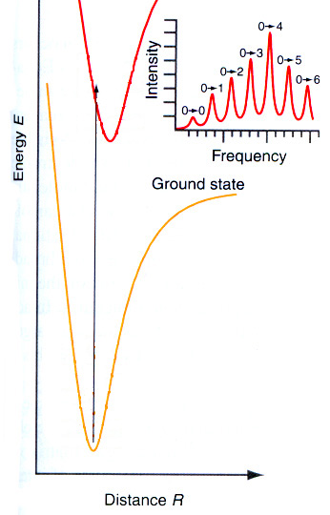
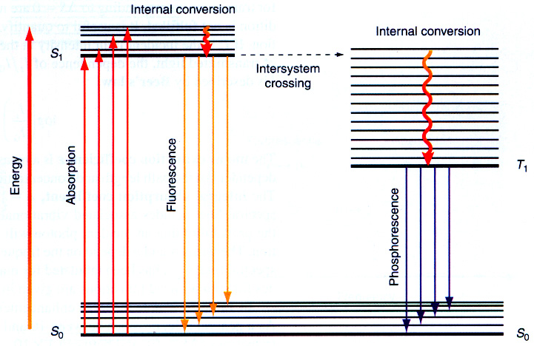
Correlation between diatomic potential energy surface (PES) and Jablonski diagram
Also remember:
Franck-Condon Principle
Jablonski

Slide 8
Nomenclature and spin states
One of the most important pieces of information about the electronic state is the total electron spin, S
If the total electron spin is zero: S = 0, then there is only one way to arrange the spins, and we have a singlet state, denoted, S
If there is one unpaired electron: the total spin is S = ½ and there are 2 ways the spin can be aligned (up and down), and we have a doublet state, denoted, D
If there are two unpaired spins: the total spin is S = ½ + ½ = 1 and there are 3 ways the spins can be aligned. This is a triplet state, denoted, T
Total Spin | Name | Symbol
0 | singlet | S
½ | doublet | D
1 | triplet | T

Slide 9
Jablonski Diagrams…
S₁
First excited singlet state
T₁
First excited triplet state
S₀
“0” = ground state
(which is a singlet in this case)
The ground state gets the symbol “0”
Other states are labelled in order, 1, 2, … according to their multiplicity

Slide 10
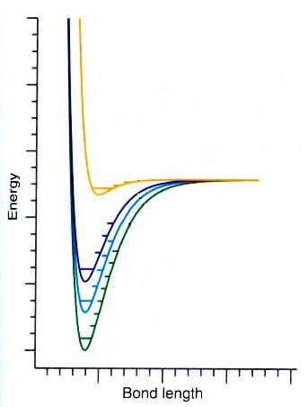
Correlation between diatomic potential energy surface (PES) and Jablonski diagram
S₁
T₁
S₀
The x-axis doesn’t mean anything in a Jablonski diagram.
Position the states to best illustrate the case at hand.

Slide 11
Jablonski diagram
E
S₂
T₂
S₁
T₁
Transitions:
photon absorption or emission
S₀
no photon involved

Slide 12
Absorption
E
S₂
T₂
S₁
T₁
S → T: forbidden transition
(∼10⁸ times smaller probability)
S₀

Slide 13
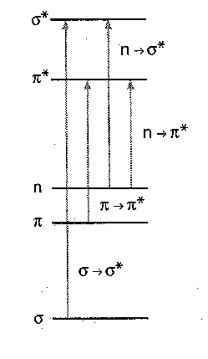
Typical absorptions
σ*
n → σ* amines, alcohols, haloalkanes
π*
n → π* carbonyls, tiocarbonyls, nitro-,
azo- and imino- group containing
compounds
n
π → π* alkenes, alkynes, aromatics
π
σ → σ* alkanes
σ

